Slide 1
UNIT-IV
PART-1: Sorting
  Insertion Sort
  Quick sort
  Merge sort
  Heap sort
  Sorting on Several Keys
  List and Table Sorts
PART-2: Hashing
  Introduction
  Static Hashing: Hash tables, Hash functions
  Overflow handlings

Slide 2
1. Insertion Sorting
Sorting is the process of arranging a list of elements in a particular order (Ascending or Descending).
Insertion sort algorithm arranges a list of elements in a particular order. In this, every iteration moves an element from unsorted portion to sorted portion until all the elements are sorted in the list.
The insertion sort algorithm is performed using following steps...
  Step 1 - Assume that first element in the list is in sorted portion and all the remaining elements are in unsorted portion.
  Step 2: Take first element from the unsorted portion and insert that element into the sorted portion in the order specified.
  Step 3: Repeat the above process until all the elements from the unsorted portion are moved into the sorted portion

Slide 3
2. Quick sort
Quick Sort is a Divide and Conquer algorithm. It is an highly efficient algorithm and is based on partitioning of array of data in to smaller arrays.
It picks an element as pivot and partitions the given array around the picked pivot. Following are the different ways to pick pivot:
  Always pick first element as pivot.
  Always pick last element as pivot (implemented below)
  Pick a random element as pivot.
  Pick median as pivot.
The key process in quick Sort is partition() - which partitions an array and then calls itself recursively twice to sort the two resulting sub-arrays.
This algorithm is quite efficient for large sized data sets as its average and worst case complexity are of O(n²).

Slide 4
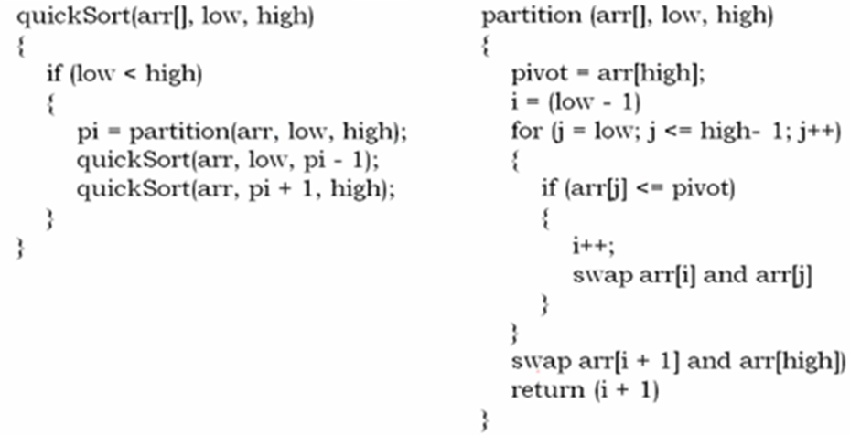
Quick Sort Functional code

Slide 5
3. Merge sort
Like QuickSort, Merge Sort is a Divide and Conquer algorithm. It divides input array in two halves, calls itself for the two halves and then merges the two sorted halves.
The merge() function is used for merging two halves.
  MergeSort(arr[], l, r)
  If r > l
  Find the middle point to divide the array into two halves: middle m = (l+r)/2
  Call mergeSort for first half: Call mergeSort(arr, l, m)
  Call mergeSort for second half: Call mergeSort(arr, m+1, r)
  Merge the two halves sorted in step c and d: Call merge(arr, l, m, r)
The merge(arr, l, m, r) is key process that assumes that arr[l..m] and arr[m+1..r] are sorted and merges the two sorted sub-arrays into one.

Slide 6
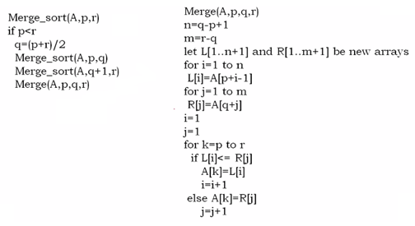
Merge sort pseudocode

Slide 7
4. Heap sort
Heap sort is a comparison based sorting technique based on Binary Heap data structure. It is similar to selection sort where we first find the maximum element and place the maximum element at the end. We repeat the same process for the remaining elements.
Heap Sort Algorithm for sorting in increasing order:
1. Build a max heap from the input data.
2. At this point, the largest item is stored at the root of the heap. Replace it with the last item of the heap followed by reducing the size of heap by 1. Finally, heapify the root of the tree.
3. Repeat step 2 while size of heap is greater than 1.
How to build the heap?
Heapify procedure can be applied to a node only if its children nodes are heapified. So the heapification must be performed in the bottom-up order.

Slide 8
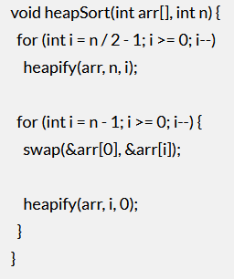
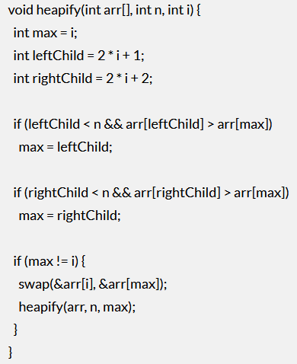
Heap Sort code

Slide 9
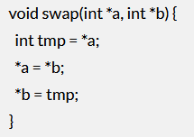
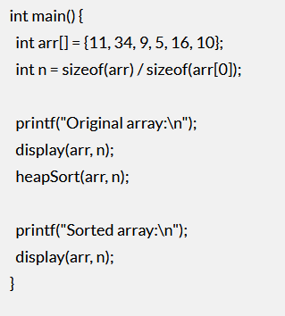
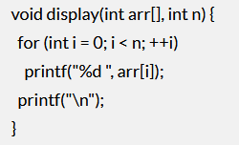
Heap Sort code

Slide 10
5. Sorting on Several Keys
It is also called as counting sorting or non-comparison sorting.
So far, we have been considering sorting based on single keys. But, in real life applications, we may want to sort the data on several keys.
The simplest example is that of sorting a deck of cards. The first key for sorting is the suit-clubs, spades, diamonds and hearts. Then, within each suit, sorting the cards in ascending order from Ace, twos to king. This is thus a case of sorting on 2 keys.
Now, this can be done in 2 ways.
1. Sort the 52 cards into 4 piles according to the suit and then Sort each of the 4 piles according to face value of the cards.
2. Sort the 52 cards into 13 piles according to face value and then Stack these piles in order and then sort into 4 piles based on suit.

Slide 11
Sorting on Several Keys…
The first method is called the MSD (Most Significant Digit) sort and the second method is called the LSD (Least Significant Digit) sort. Digit stands for a key.
Though they are called sorting methods, MSD and LSD sorts only decide the order of sorting. The actual sorting could be done by any of the sorting methods discussed in this unit.

Slide 12
7. Hashing - Introduction
Hashing is another approach in which time required to search an element doesn't depend on the number of element.
Using hashing data structure, an element is searched with constant time complexity. Hashing is an effective way to reduce the number of comparisons to search an element in a data structure.
Hashing is the process of indexing and retrieving element (data) in a data structure, to provide faster way of finding the element using the hash key.
In this data structure, we use a concept called Hash table to store data. All the data values are inserted into the hash table based on the hash key value.
Hash key value is used to map the data with index in the hash table. And the hash key is generated for every data using a hash function i.e. every entry in the hash table is based on the key value generated using a hash function.

Slide 13
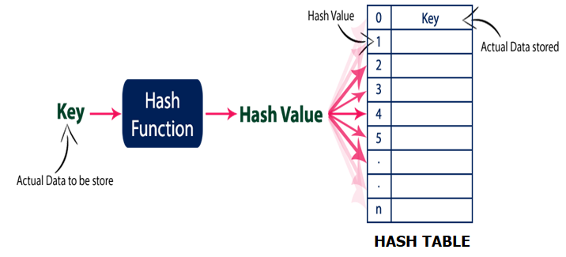
Hashing – Introduction…
The efficiency of mapping depends of the efficiency of the hash function used.
Basic concept of hashing and hash table is shown in the following figure. Here ‘n’ indicate maximum number of slots or buckets available in Hash table to store data elements.

Slide 14
Hashing – Introduction…
There are two types of hashing – Static and Dynamic.
In static hashing, the resultant data bucket address is always the same. In other words, the bucket address does not change. Thus, in this method, the number of data buckets in memory remains constant throughout.
An issue in static hashing is bucket overflow. Dynamic hashing helps to overcome this issue. It is also called Extendable hashing method.
In this method, the data buckets increase and decrease depending on the number of records. It allows performing operations such as insertion, deletion etc. without affecting the performance.

Slide 15
2. Static Hashing
Hashing is a technique through which given data can be stored/retrieved from hash table.
For this a hash function is required which can generate an integer value for the given input. This integer value also known as hash value can be used to store given value to particular index of hash table.
The two principal criteria in selecting a hash function are -
    1. It should be easy and quick to compute.
    2. It should achieve an even distribution of the keys that actually occur across the range of indices.
There are many ways to create an hash function.
Division method, Folding Method, MidSquare Method

Slide 16
Static Hashing…
Division Method: If there are m slots available, then the key is mapped to given m slots using following formula:-
h(k) = k mod m.
Folding Method: In this, the given key is partitioned into subparts k1, k2, k3, k4 ...... kn each of which has the same length as the required address. Now add all parts together and ignore the carry.
For example:- if number of buckets be 100 and last address/index be 99, then the given key for which hash code is calculated is divided into parts of two digits from beginning as shown below
    h(95073) = h(95 + 07 + 3)
    = h(105) //ignoring the carry
    = 5

Slide 17
Static Hashing…
MidSquare Method: In this, hash code for given key is obtained by squaring the key and taking m bits from the middle to obtain the bucket address.
The number of bits used to obtain the bucket address depends on the table size. For example:- If the size of table is 100, then we can fetch 2 bits/digits from middle.
Since the middle bits of the square depend upon all the bits of the given key, there is a high probability that different key will generate different hash code.
Example:
k: 3205 7148 2345
k²: 10272025 51093904 5499025
H(k): 72 93 99

Slide 18
3. Overflow Handling in Hashing
An overflow occurs at the time of the home bucket for a new pair (key, element) is full.
As we know hash function is used to generate index/address of particular key in hash table. Note it may be the case that for two keys we get same hash code. This is known as collision.
Hence if a hash function that maps each key to a distinct address/index, it is known as perfect hash function. To design perfect hash function, usually all the keys must be known beforehand.
There are two ways to handle overflows / collisions: Open addressing and Separate chaining.
Open addressing: In this, all elements are stored in the hash table itself. So at any point, the size of the table must be greater than or equal to the total number of keys (Note that we can increase table size by copying old data if needed).

Slide 19
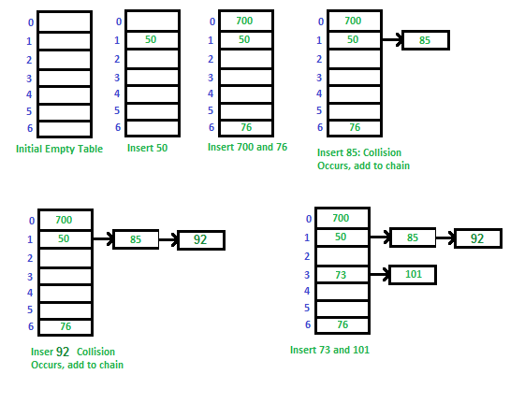
Overflow Handling in Hashing…
Separate Chaining: The idea is to make each cell of hash table point to a linked list of records that have same hash function value.
Example: Let us consider a simple hash function as “key mod 7” and sequence of keys as 50, 700, 76, 85, 92, 73, 101.

Slide 20
Overflow Handling in Hashing…
In simple chaining, load factor is the average number of elements stored in a chain, and is given by the ratio of number of elements stored to the number of slots in the array i.e. average chain length..
In simple chaining, since deletion will be easier with double linked list, we use frequently Double Linked list as compared to other DSs.

Slide 21
Open Addressing
The Open/Close addressing is another technique for collision resolution. Unlike chaining, it does not insert elements to some other data-structures. It inserts the data into the hash table itself. The size of the hash table should be larger than the number of keys.
There are three different popular methods for open addressing techniques. These methods are −
Linear Probing, Quadratic Probing, Double Hashing
Linear Probing: In this, we linearly probe (try) for next slot. The increment of slot after every try is generally 1.
The basic function hi is some hash function Hash(X) plus iteration sequence “i” modulo HashTableSize.
Hi (X) = (Hash(X) + i) % HashTableSize
This will give the slot to probe.

Slide 22
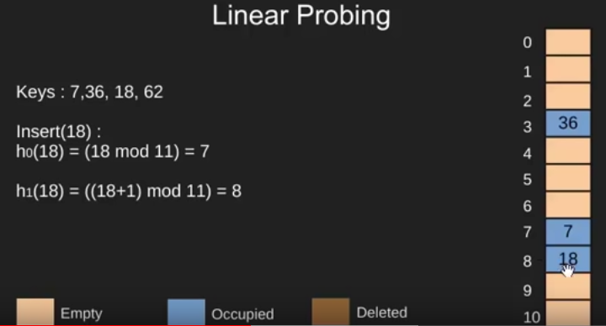
Open Addressing…
For Example:
If h0 = (Hash(X) + 0) % HashTableSize is full, we try for h1
If h1 = (Hash(X) + 1) % HashTableSize is full, we try for h2
And so on… Let us consider operations – insert, delete, search

Slide 23
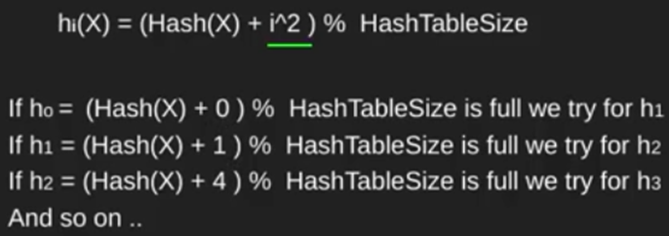
Open Addressing…
Quadratic Probing :

Slide 24
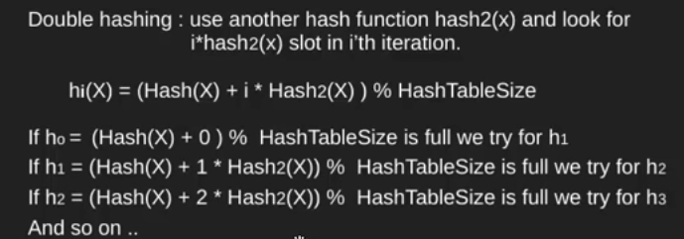
Open Addressing…
Double Hashing:

Slide 25
END OF
UNIT-4

